Slide 1
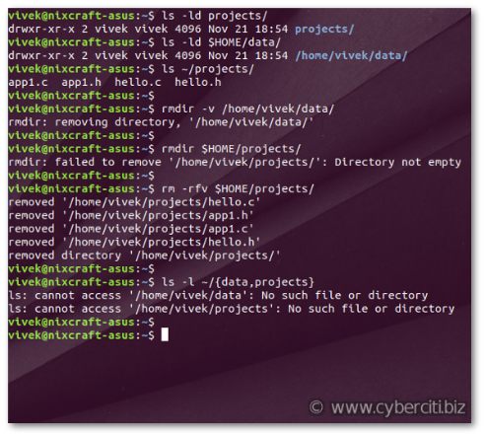
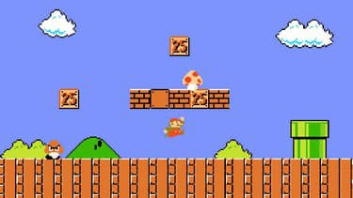
Python libraries
From terminal to gaming

Slide 2
What is a library ?
from random import shuffle
students = ["Chanthy", "Bunthoeun", "Sreyleak", "Nika", "Sambo"]
shuffle(students)
print(students)
Try the code below.
What is printed ?
Try it again….
What is printed ?

Slide 3
What is a library ?
random is a library
shuffle is a function in the library which we want to use in our code
from random import shuffle
students = ["Chanthy", "Bunthoeun", "Sreyleak", "Nika", "Sambo"]
shuffle(students)
print(students)
After import i can use shuffle as if it was my own function !
Notes:
01-random.py

Slide 4
The Random function
Activity
10 minutes
This is the list of functions in the library random:
https://www.w3schools.com/python/module_random.asp
Create a code that displays 3 random numbers between 0 and 100
The numbers must be different every time I run code
« randrange » is your friend
Example :
Number 1 : 22
Number 2 : 82
Number 3 : 17
Example :
Number 1 : 72
Number 2 : 55
Number 3 : 89

Slide 5
The Random function
from random import randrange
print(randrange(0,100))
print(randrange(0,100))
print(randrange(0,100))
Notes:
02-random.py

Slide 6
Lover finder
Activity
20 minutes
Use the starting code « 03-secretlover-startCode.py » to create a program that discover who is your secret lover
Input :
Ask user to input his name
Output :
Print the name of the secret lover choosen randomly in the student array
What is your name ? Rady
Rady secret lover is Sophea
What is your name ? Jonathan
Jonathan secret lover is Chanthy
What is your name ? Ronan
Ronan secret lover is Sreyneth
What is your name ? Seiha
Seiha secret lover is Dyna
Notes:
03-secretlover-startCode.py
03-secretlover-correction.py

Slide 7
TK library
TK is a library to display windows and draw shapes
This is the basic code to display an empty window.
Use it for every exercise !
import tkinter as tk
# Create an empty window
root = tk.Tk()
# Set TK window size to width 600 px and height 200 px
root.geometry("600x200")
# Create a frame in the window (frame is a container, like "div" in HTML)
frame = tk.Frame()
# Set the title of the frame
frame.master.title("Hello PNC")
# HERE YOU CAN START TO DRAW
# Display all
root.mainloop()
Notes:
04-TK-intro.py

Slide 8
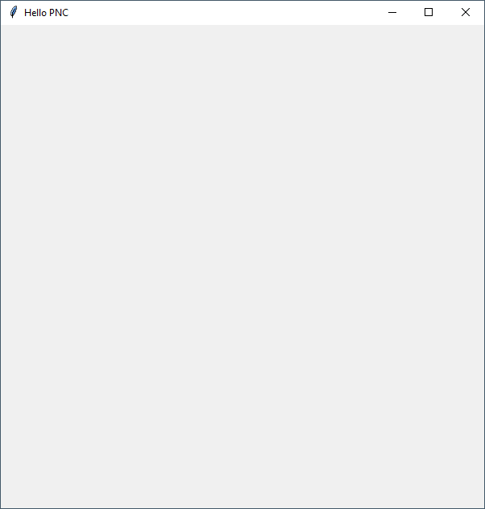
create_rectangle(x1, y1, x2, y2, optional parameters…)
create_rectangle(10, 20, 50, 100, fill="#0000FF")
X1 X2
10 50
x
0
Y1 20
What is the width of the rectangle ?
What is the height of the rectangle ?
Y2 100
y

Slide 9
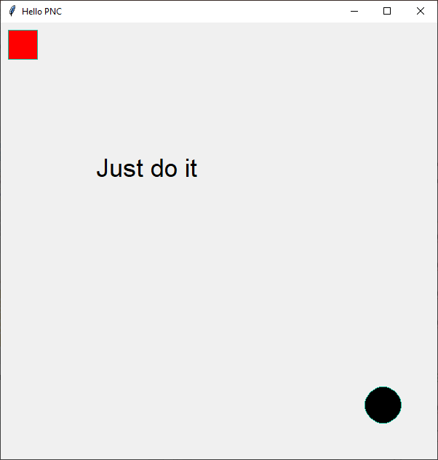
TK library
Optional parameter syntax.
If you dont put it, your rectangle will have transparent background
canvas = tk.Canvas(frame)
canvas.create_rectangle(10, 10, 50, 50, fill="#FF0000")
canvas.create_oval(500, 500, 550, 550, fill="#000000")
canvas.create_text(200, 200, text="Just do it", font=("Purisa", 26))
# pack means "draw what you put inside"
canvas.pack(expand=True, fill='both')
frame.pack(expand=True, fill='both')
Notes:
05-TK-rectangle-oval.py

Slide 10
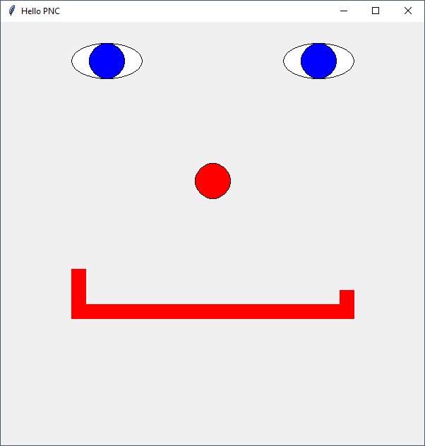
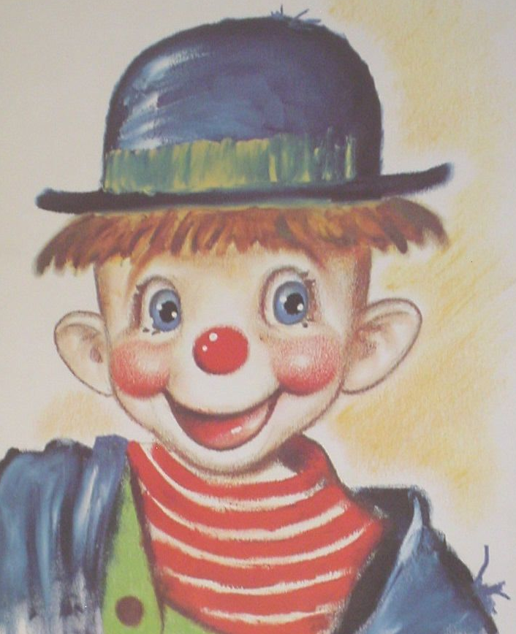
Blue eyes clown
Activity
30 minutes
My drawing skill in python is so good right ?
How many rectangles in this guy ?
How many ovals ?
Code it !
Try to do better than me if possible ! Next session we have a beauty contest of your clowns
Notes:
06-TK-blue-eyes-guy-CORRECTION.py

